Slide 1

DISPLAy BOOKSHELVES

Slide 2
TEAM MEMBERS:
Shubham Mishra – 890843
Rama Chandra Prasad Chakali – 890460
Shubham Lokare – 890247
Rohit Jujaray – 891070
Goje Niharika - 890161

Slide 3
Introduction:
To build a good application, which is reliable, scalable and maintainable, it is important for QA teams to adopt proven design techniques and good coding standards.
In the below presentation ,we will under the working of the website "Urban Ladder" to display the bookshelves.
We will also know about the technologies and displaying screenshots that are used to know the working of the site.

Slide 4
Technologies Used:
1.Selenium for testing web application.
2.TestNG for unit testing.
3.Apache POI for Page Object Model.
4.Maven for building the project.
5.Jenkins for Continuous integrations.
6.MS Excel for manage data.

Slide 5
TEST CASE-1
1. Launching website.
2. Checking if search button is working.
3. Keeping the text box empty.
4. Searching for Bookshelves.
5. Checking the Excluding out of stock button.
6. Searching for bookshelves.

Slide 6
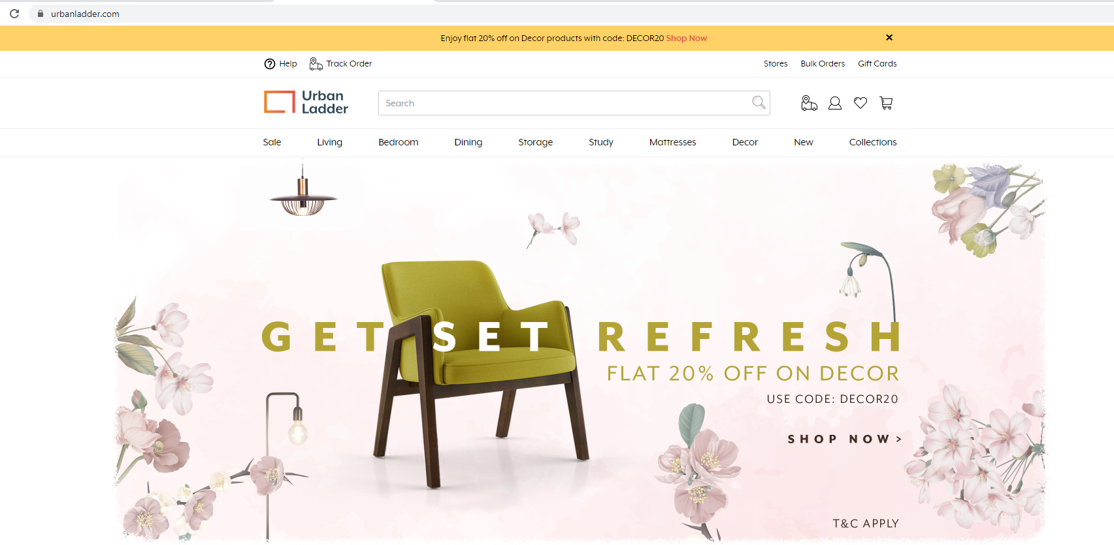
Firstly, we validate the site ” https://urbanladder.com “. This is the main page of the website “Urban Ladder”.

Slide 7
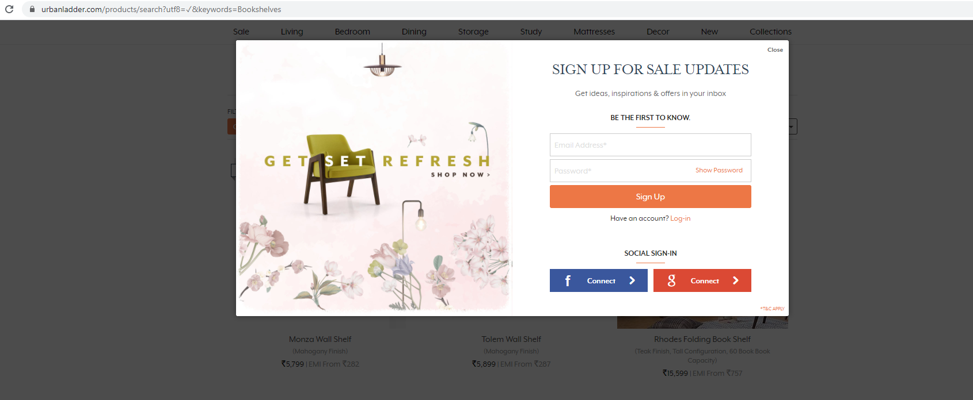
As we are on the website there is a log in pop up which has to be closed.

Slide 8
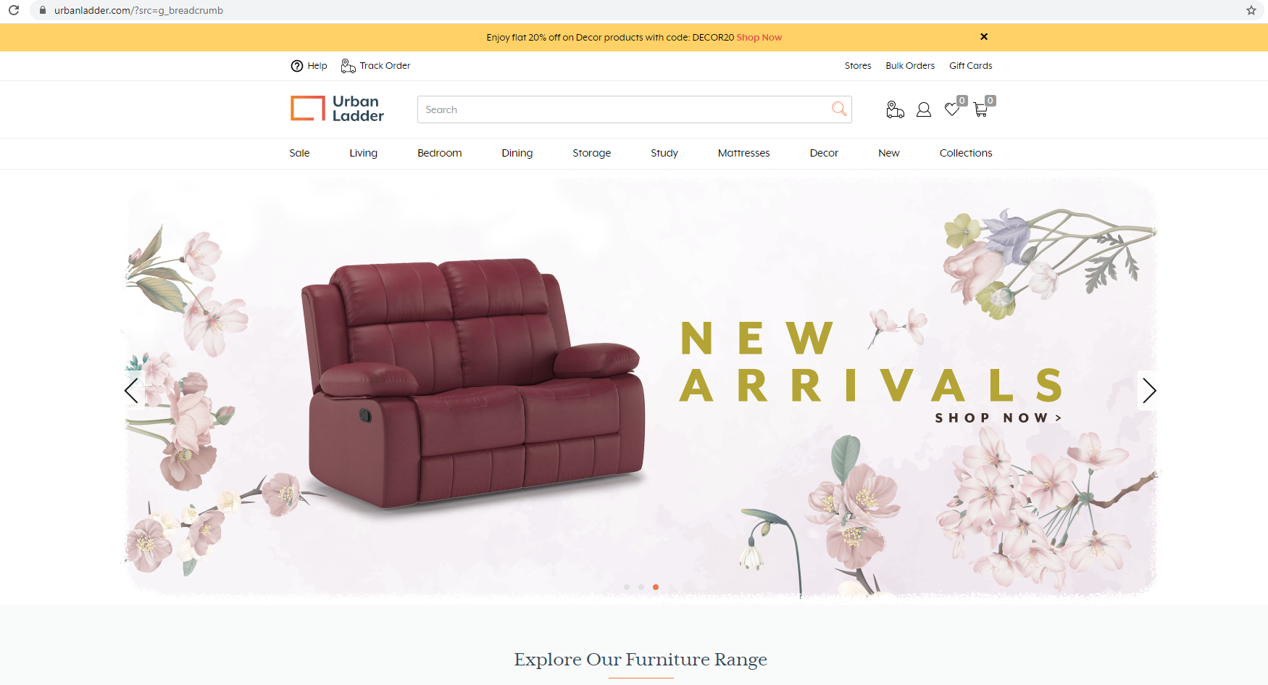
We will check weather the search button is working by keeping the text box empty and we notice that the search button doesn’t work.

Slide 9
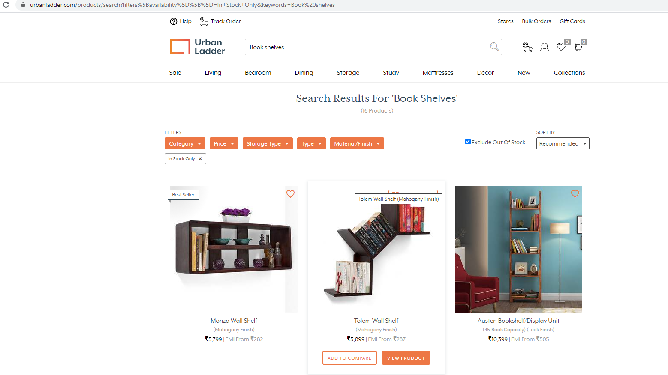
Search for ”Bookshelves”. Select storage type and check on “Exclude out of stock” is working or no. And then the values of first three bookshelves below 15,000/- are taken and displayed into the console.

Slide 10
TEST CASE-2
Search for collections.
Checking the dropdown list.
Selecting being at home from collections.
Displaying the sub menu list.

Slide 11
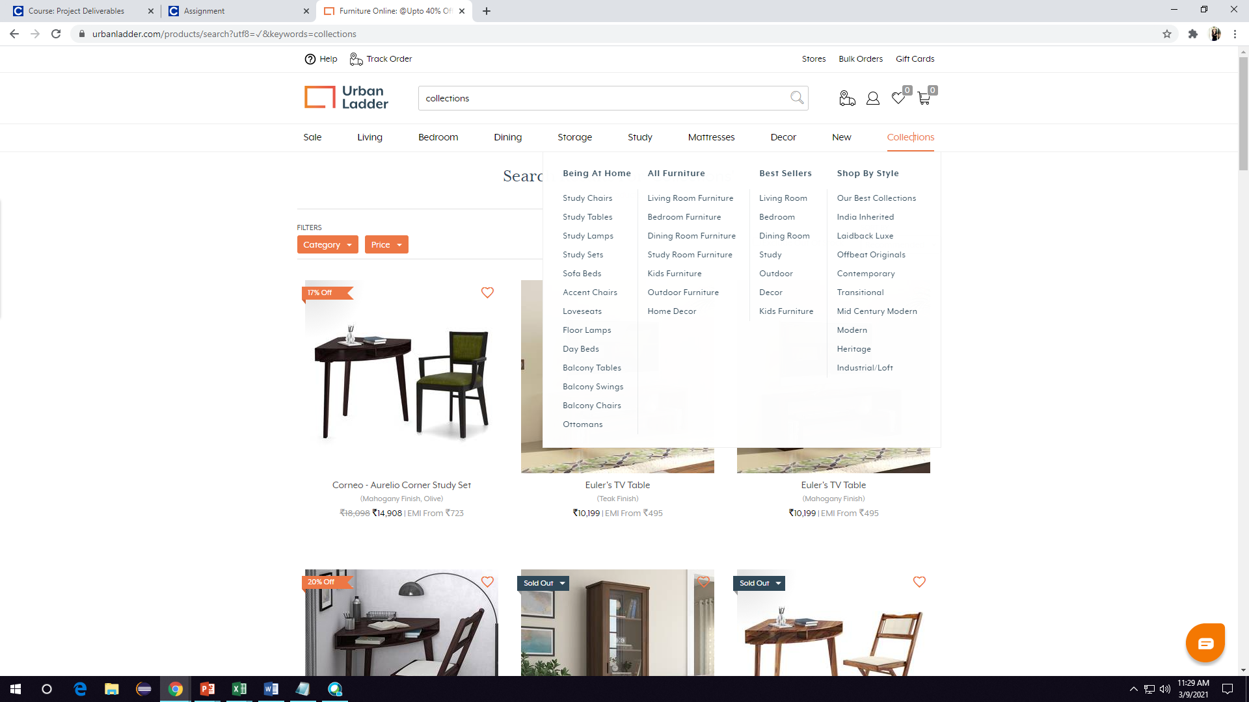
In this scenario, we firstly search for “Collections” and check weather the drop down list is working or no .

Slide 12
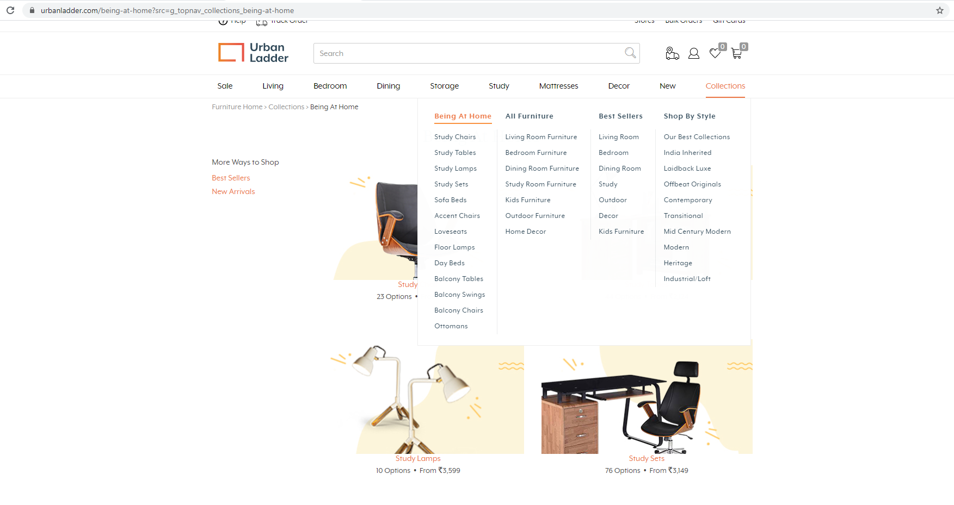
Next , we check for “Being at home” from collections. The sub menu list from ‘Being at home’ are displayed .

Slide 13
TEST CASE-3 PART-1
Validate Gift cards.
Selecting the occasion
Entering the amount.
Checking the Next button.
Selecting “Send on” dates and checking drop down lists.

Slide 14
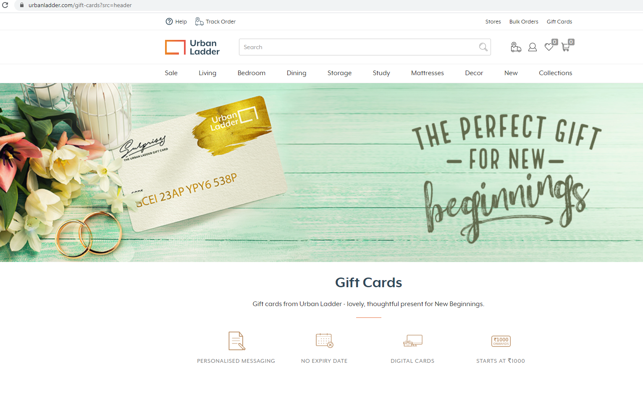
Firstly, we select “Gift cards” option from the home page.

Slide 15
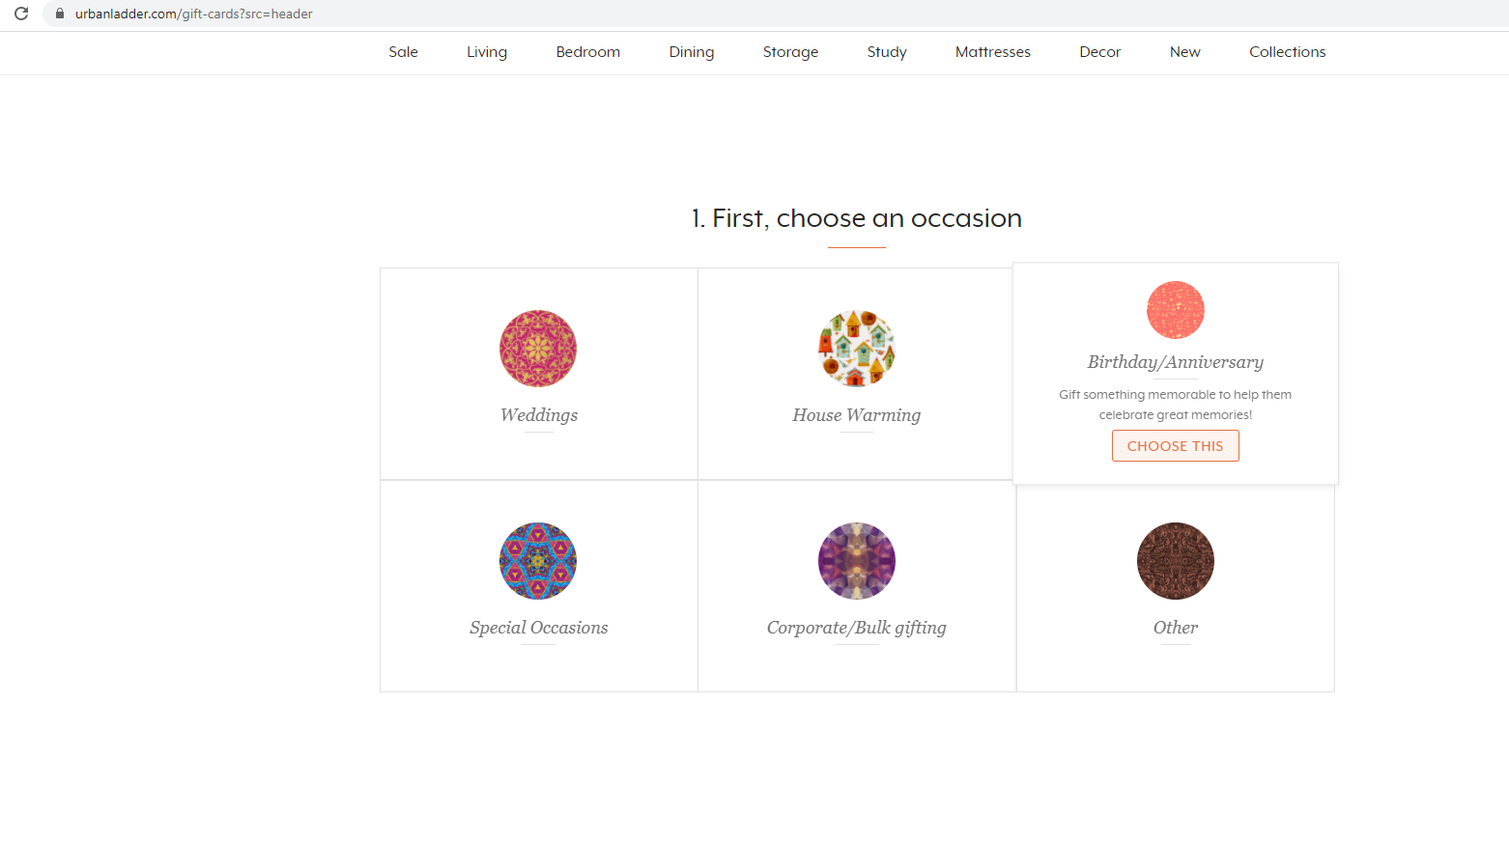
Select the occasion from the below options. We are selecting “Birthday/Anniversary” as our occasion.

Slide 16
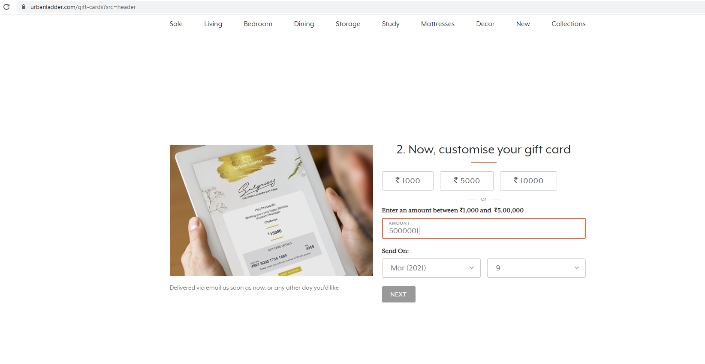
It leads us to the next module to customize the gift card. In this we try to enter the amount more than 5,00,000. We notice that the Next button is disabled .

Slide 17
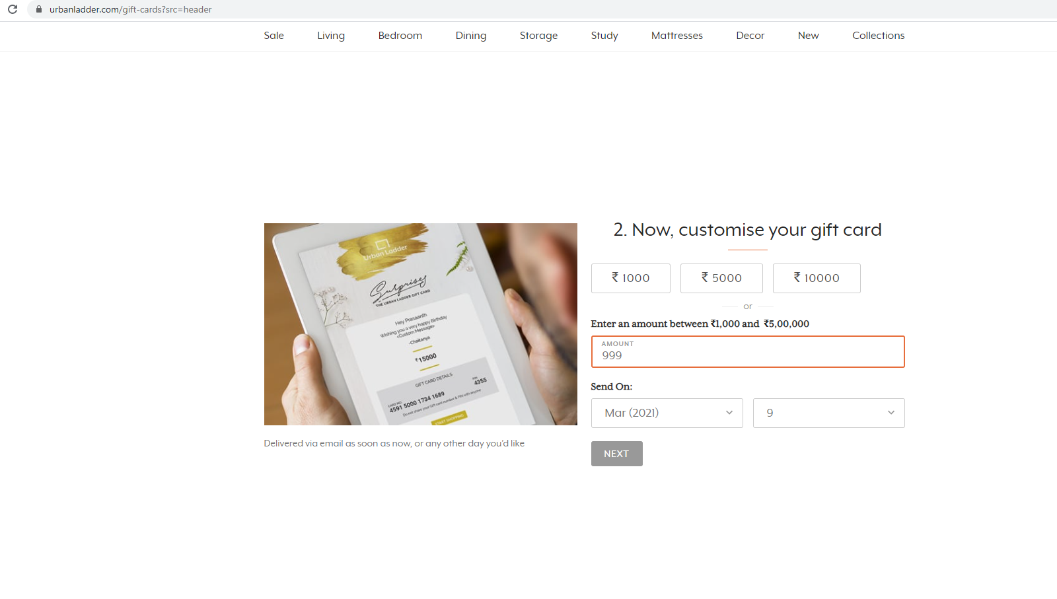
We will enter the amount less than 1000 and we notice the Next button is disabled.

Slide 18
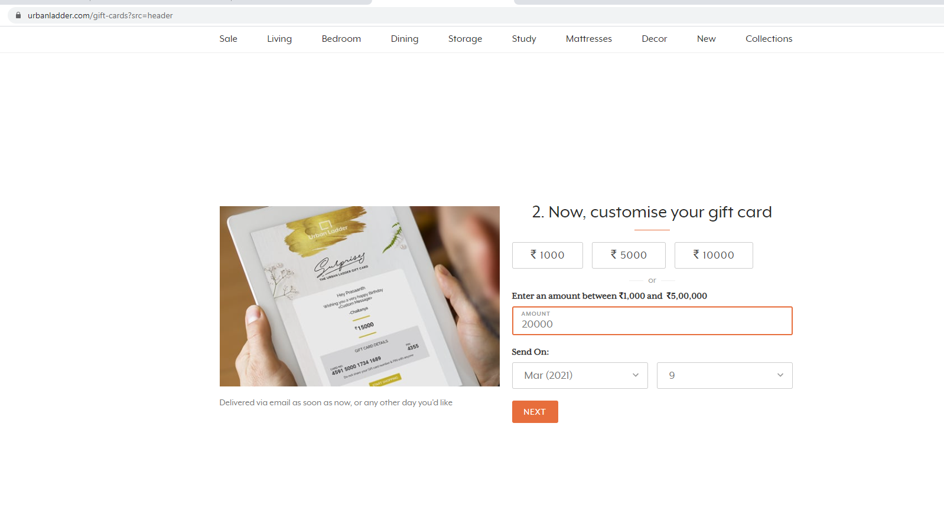
Now , we enter the correct amount within the given range. That is more than 1,000 and less than 5,00,000. The Next button is enabled.

Slide 19
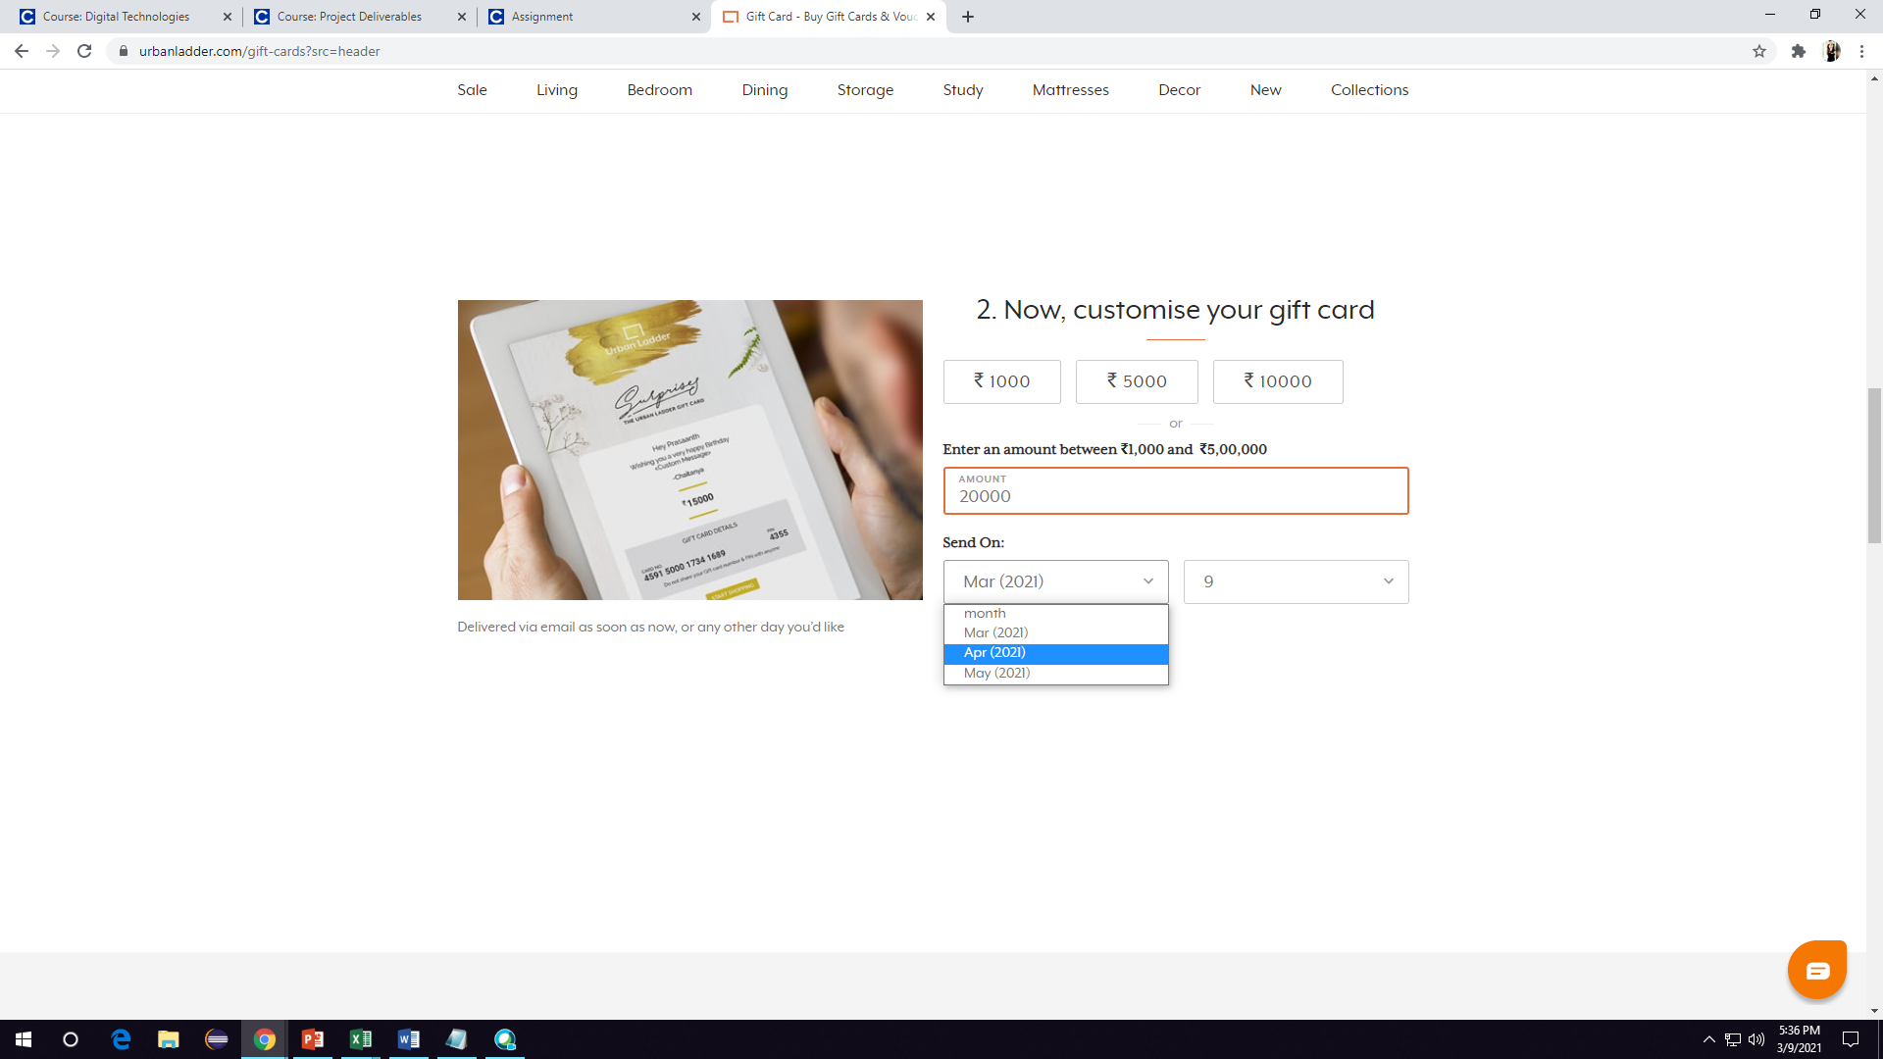
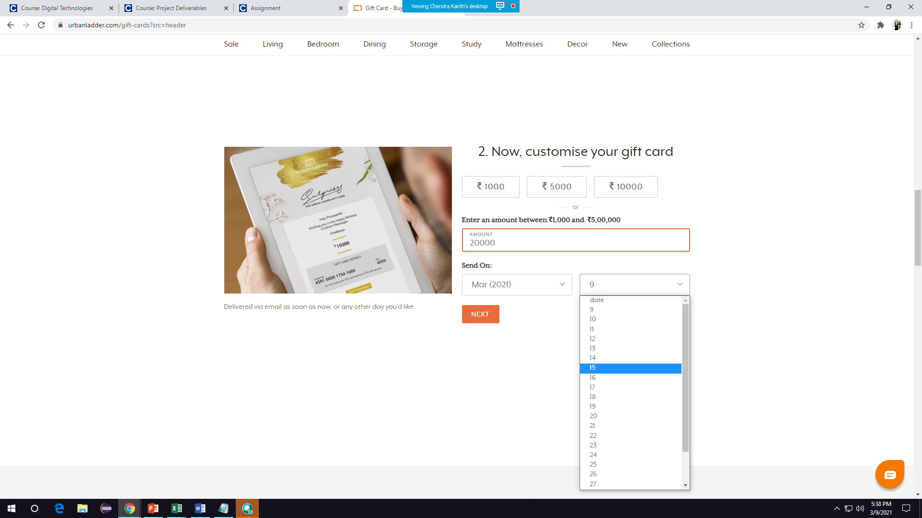
The date to send should be selected from the drop down list. We should be able to select the date and month from thedrop down list.

Slide 20
TEST CASE-3 PART-2
Customizing without Email.
Customizing without Name.
Customizing without Phone number.
Entering message more than 20 words.
Entering invalid data.

Slide 21
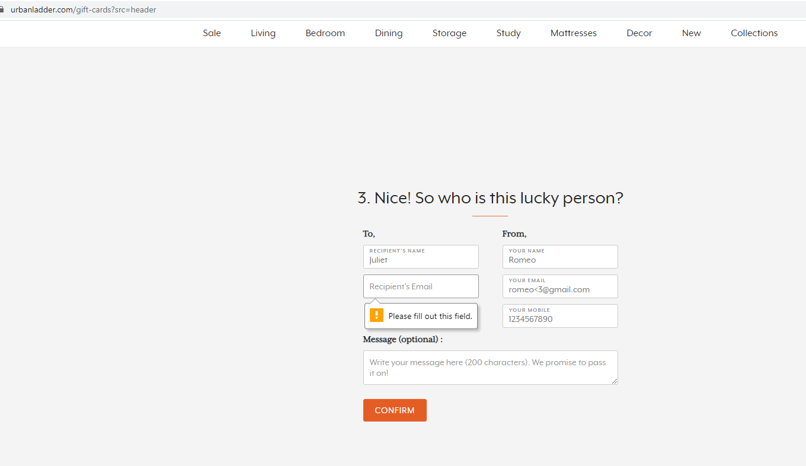
After entering the amount, we are lead to the next module where we have to give the details of the person whom we are sending the gift card. In the first scenario, we are filling the details without the email address and we get and error which says “Please fill out this field”.

Slide 22
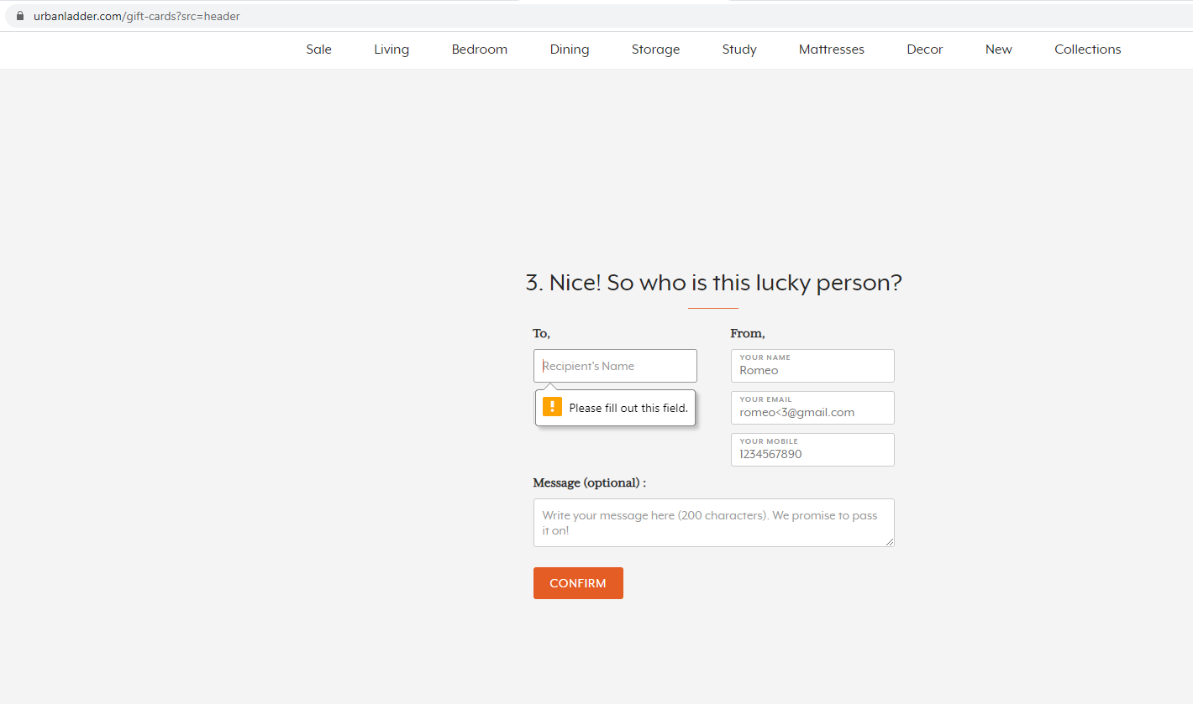
In the second case, we try to not fill the name and try to confirm the module. Here, we notice that there is an error that says “ Please fill out this field”.

Slide 23
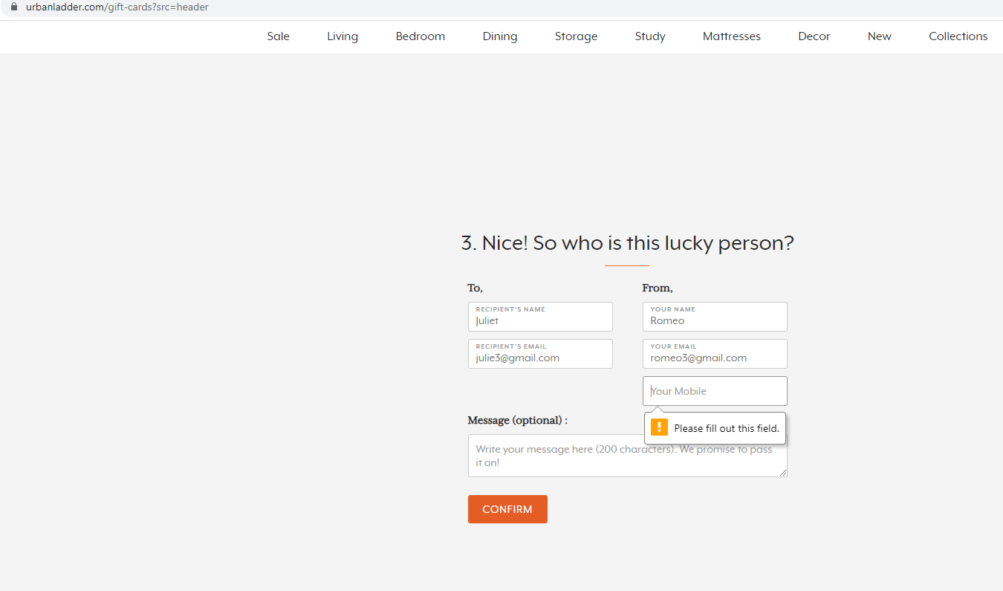
In this scenario, we keep the phone number empty and confirm. We again get an error that says “ Please fill out this field”.

Slide 24
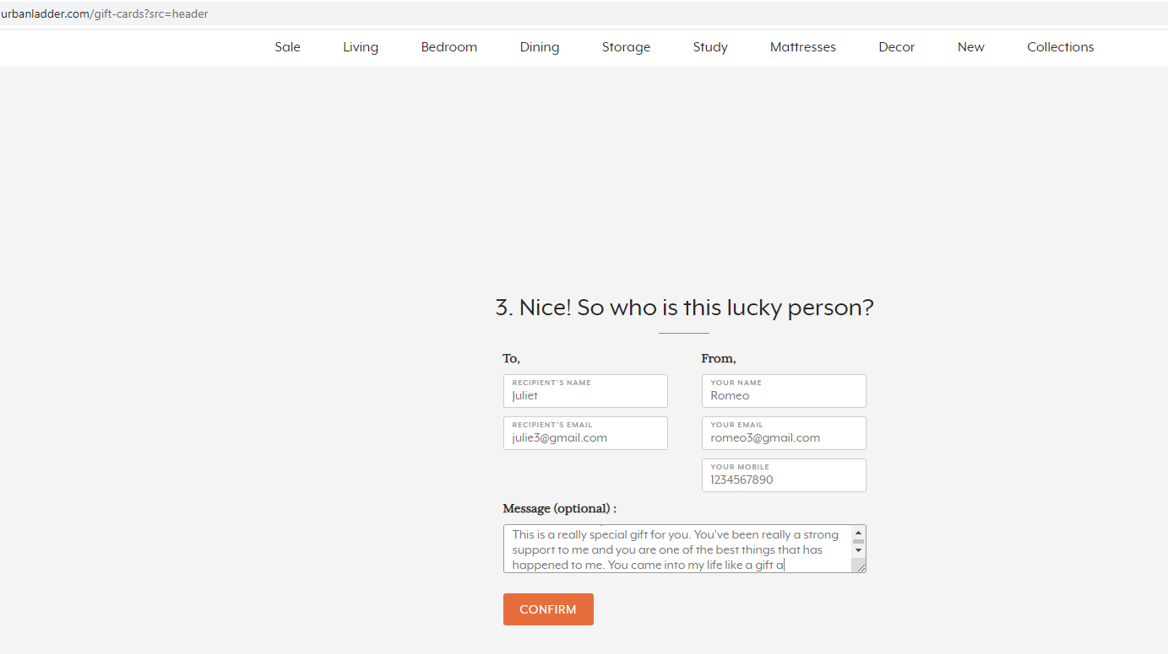
When we try to give a message more than 200 words , we don’t get to move forward after the limit of 200 words exceeds. The message has to be only of 200 words.

Slide 25
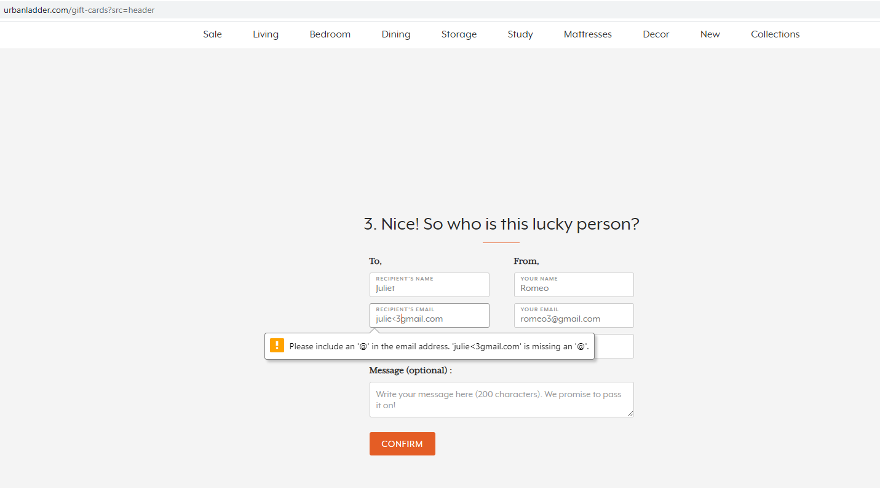
In this last scenario, we try to give an invalid email and this time we have an error displayed according to the error. In the below invalid email we have given a special character and missed @ symbol. The error we get is “Please include an ‘@’ in the email address. ‘Julie<3gmail.com’ is missing an ‘@’.”.

Slide 26
TEST CASE-4
1. Search for study chairs.
2. Display highly suggested study chairs with their prices.

Slide 27
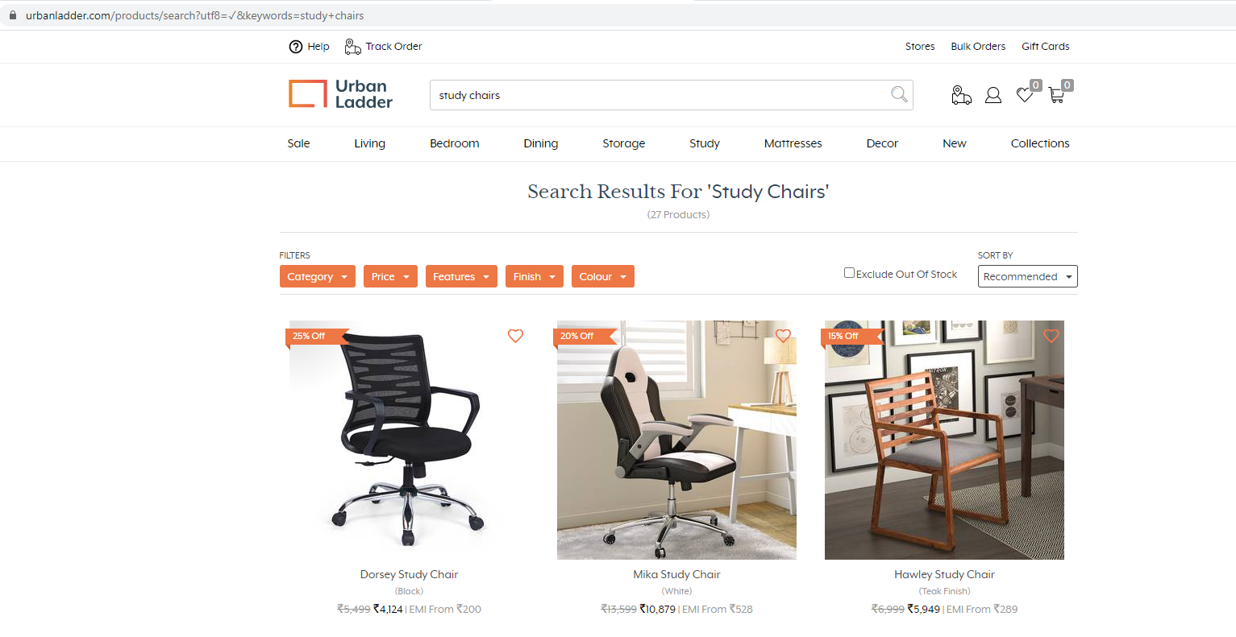
In this case, we search for “Study chairs”. We display the highly recommended first three study chairs with their prices.

Slide 28


